Slide 1
INFO 2201
Programming for Information Science
MTWTh 1 pm- 2:40 pm Meets Remotely
2023-06-05 through 2023-07-28
Zoom Link: https://cuboulder.zoom.us/my/anasb

Slide 2
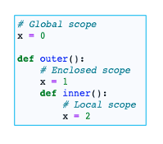
Scopes

Slide 3

Python object
an object is simply some code plus data structures that are smaller than a whole program
An object can contain a number of functions (which we call methods) as well as data that is used by those functions. We call data items that are part of the object attributes.
We use the class keyword to define the data and code that will make up each
of the objects.

Slide 4
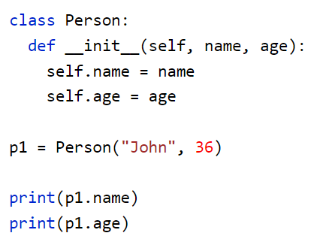
Class example
The variables in a class are called properties
The __init__ runs on class initialization

Slide 5
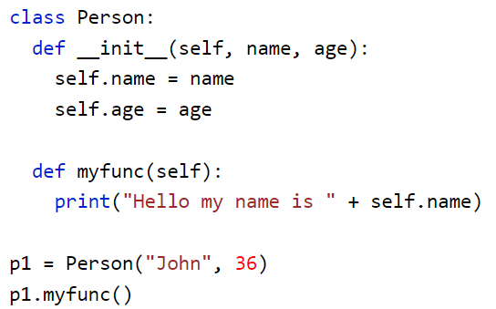
Methods
Methods are functions within the object

Slide 6
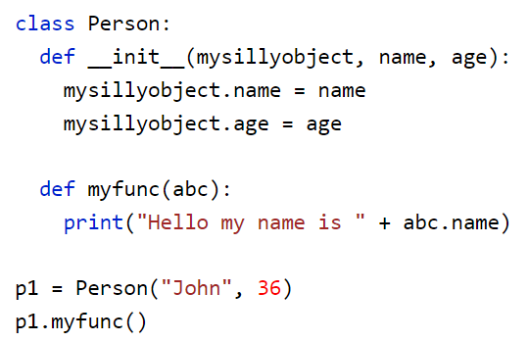
The self parameter
The self parameter is a reference to the current instance of the class, and is used to access variables that belongs to the class.
It does not have to be named self , you can call it whatever you like, but it has to be the first parameter of any function in the class:

